Slide 1
DATA
DESIGN

Slide 2
Designing Tables
Consider cataloging your CD collection
CD(CDId, Title, ReleaseYear, Band, Genre)
TRACK(TrackId, CDId, Track#, SongTitle, Duration)

Slide 3
Designing Tables
But what about
"Best of" CD with tracks from various CDs
Burn own CD with same songs in different order
CDs with songs from various bands, band per track?
CD with various genres, genre per track?
Performers in band

Slide 4
Class Diagrams...
Let's not think of tables at first, instead think of entities, relationships, & attributes
Class diagram describes the world in terms of entities and how they relate to one another
A class is a type of entity and is represented by box; they correspond to tables
Easier think graphically than bunch of tables

Slide 5
Many Ways to Represent Data
English | Graphical (UML, ERD) | SQL | Object
Actors are cast in movies |  | create table actors ( id int; name varchar(50); primary key(id); ); create table movies ( id int; name varchar(50); primary key(id); ); create table casting ( actor_id int; movie_id int; foreign key actor_id references actors.id; foreign key movie_id references movies.id; ); | class Actor { Movie[] movies; } class Movie { Actor[] actors; }
Actor
*
casting
*
Movie

Slide 6
UML Class Diagrams
Relationships are represented by lines; they correspond to foreign keys
Attributes describe entities and have values; they correspond to fields
Eventually convert class diagrams to tables
Use UML (Unified Modeling Language)

Slide 7
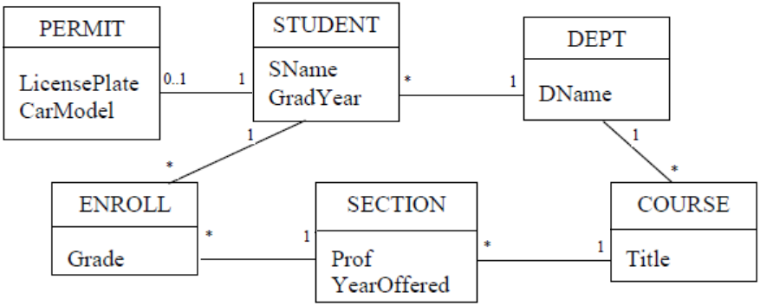
UML Class Diagram Example
STUDENT participates in 3 relationships
Classes have zero or more attributes

Slide 8
Relationship Cardinality
Cardinality denotes how many entities participate in the relationship
In general cardinality is denoted as N..M
* denotes zero or more participants
* is a shorthand for 0..*
1 is a shorthand for 1..1
1, *, and 0..1 are the most common
These are referred to as annotations

Slide 9
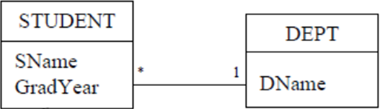
One-Many Relations
The * next to STUDENT indicates record in DEPT can be related to zero or more STUDENT records
The 1 next to DEPT indicates that each STUDENT record must have exactly one major department
This is referred to as a one-many or many-one relationship

Slide 10
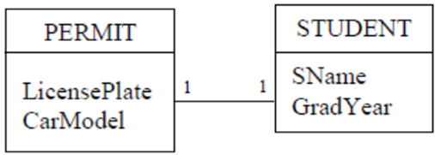
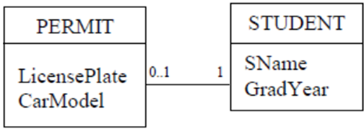
One-One and Optional Relations
A one-one relationship is strong-strong. Both instances must exist in the relationship
The 0..1 next to PERMIT denotes zero or 1, i.e, a PERMIT is optional

Slide 11
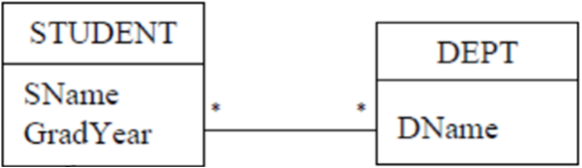
Many-Many Relations
If we change 1 next to DEPT to * it means student could declare several majors
Referred to as many-many relationship

Slide 12
Relationship Strength
The annotation 1 is considered a strong annotation because requires participation of an entity
The * and 0..1 annotations do not require participation (they are optional), therefore we refer to them as weak annotations
Example relationship are all weak-strong

Slide 13
Relationship Strength
Many-many relationships are weak-weak, as well as one-one relations with 0..1 on both sides
One-one relations with 1 on both sides are strong-strong relations

Slide 14
Example Relationship Strengths
Relationship | Example
weak-strong | *-1, 0..1-1
strong-weak | 1-*, 1-0..1
weak-weak | *-*, *-0..1, 0..1-*, 0..1-0..1
strong-strong | 1-1, 2-4

Slide 15
VISUALLY READING
CLASS DIAGRAMS

Slide 16
Visually Reading a Class Diagram...
By inspecting example class diagram we can infer:
students are enrolled in sections of courses
we can determine all courses taken by a student
all students taught by a given professor in a given year
average section size of a given course

Slide 17
Visually Reading a Class Diagram
We cannot determine
which students changed majors
which professor advises which student
We can add additional annotations to make relationships clearer

Slide 18
(Note lack of primary and foreign keys)
students are enrolled in sections of courses

Slide 19
1
1
*
*
*
1
*
1
(primary and foreign keys are implied)
students are enrolled in sections of courses

Slide 20
STUDENT
SID | SName
123 | Alice
345 | Bob
456 | Chuck
DEPT
DID | Title
10 | CCIS
20 | LAW
1
1
*
*
ENROLL
EID | SID | SCID | Grade
1 | 123 | 321 | A
2 | 123 | 567 | B
3 | 345 | 567 | A-
4 | 456 | 567 | B+
SECTION
SCID | CID
321 | 5610
432 | 5610
567 | 4500
678 | 4500
COURSE
CID | Title | DID
5610 | Web | 10
4500 | SoftEng | 10
3200 | DB | 10
4321 | Debate | 20
*
1
*
1
students are enrolled in sections of courses

Slide 21
STUDENT
SID | SName
123 | Alice
345 | Bob
456 | Chuck
DEPT
DID | Title
10 | CCIS
20 | LAW
(keys are database artifacts)
1
*
PK
ENROLL
EID | SID | SCID | Grade
1 | 123 | 321 | A
2 | 123 | 567 | B
3 | 345 | 567 | A-
4 | 456 | 567 | B+
SECTION
SCID | CID
321 | 5610
432 | 5610
567 | 4500
678 | 4500
COURSE
CID | Title | DID
5610 | Web | 10
4500 | SoftEng | 10
FK

Slide 22
STUDENT
SID | SName
123 | Alice
345 | Bob
456 | Chuck
DEPT
DID | Title
10 | CCIS
20 | LAW
ENROLL
EID | SID | SCID | Grade
1 | 123 | 321 | A
2 | 123 | 567 | B
3 | 345 | 567 | A-
4 | 456 | 567 | B+
SECTION
SCID | CID
321 | 5610
432 | 5610
567 | 4500
678 | 4500
COURSE
CID | Title | DID
5610 | Web | 10
4500 | SoftEng | 10
*
1
FK
PK

Slide 23
STUDENT
SID | SName
123 | Alice
345 | Bob
456 | Chuck
DEPT
DID | Title
10 | CCIS
20 | LAW
ENROLL
EID | SID | SCID | Grade
1 | 123 | 321 | A
2 | 123 | 567 | B
3 | 345 | 567 | A-
4 | 456 | 567 | B+
SECTION
SCID | CID
321 | 5610
432 | 5610
567 | 4500
678 | 4500
COURSE
CID | Title | DID
5610 | Web | 10
4500 | SoftEng | 10
*
1
PK
FK

Slide 24
STUDENT
SID | SName
123 | Alice
345 | Bob
456 | Chuck
DEPT
DID | Title
10 | CCIS
20 | LAW
Often keys included in UML for documentation
1
PK
*
ENROLL
EID | SID | SCID | Grade
1 | 123 | 321 | A
2 | 123 | 567 | B
3 | 345 | 567 | A-
4 | 456 | 567 | B+
SECTION
SCID | CID
321 | 5610
321 | 5610
567 | 4500
678 | 4500
COURSE
CID | Title | DID
5610 | Web | 10
4500 | SoftEng | 10
FK

Slide 25
TABLES TO
CLASSES

Slide 26
Transforming Tables to Class Diagrams
Class diagrams consists of / and correspond to
Class Diagram Relational Model
Classes Tables
Attributes Fields/Columns
Relationships Foreign keys & Primary Keys
Often need to represent data in many formats

Slide 27
Transforming Tables to Class Diagrams
Foreign keys correspond to weak-strong relations
Consider the CD database we introduced earlier
The Relational Model:
CD(CDId, Title, ReleaseYear, Band, Genre)
TRACK(TrackId, CDId, Track#, SongTitle, Duration)
LYRICS(TrackId, Lyrics, Author)

Slide 28
Foreign Key Relationships...
LYRICS table holds lyrics and author for each track
LYRICS.TrackId is both primary AND foreign key
Each track can have at most one lyrics
Constraints
Many TRACK records have one CD record
One LYRICS record has one TRACK record

Slide 29
Foreign Key Relationships
No constraints, we infer
One CD record can have many (or 0) TRACK records
One TRACK record can have one (or 0) LYRICS records
Foreign keys express many-one relationship between CD and TRACK (* - 1)
And optional LYRICS record for TRACK (0..1-1)

Slide 30
TRACK
TrackId | CDId | Track# | Duration
 | 123
 | 123
 | 123
 | 234
 | 234
CD
CDId | Title | Year | Band | Genre
123
234
345
TRACK
TrackId | CDId | Track# | SongTitle
321 | 123
432 | 123
543 | 123
654 | 234
765 | 234
LYRICS
TrackId | Lyrics | Author
321
432
543
654
765

Slide 31
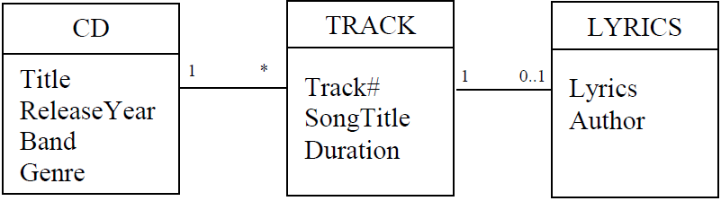
CD Database Class Diagram
No attributes for keys and foreign keys
Keys and foreign keys only for relationships
Class diagrams use lines for relationships, no need for keys and foreign keys, it's implied
Use: relationships correspond to foreign keys
PK
1
*
FK

Slide 32
Relational Schema ➔ Class Diagram
Create a class for each table in the schema.
If table T1 contains foreign key to table T2, then create relationship between classes T1 and T2. Annotation next to T2 is “1”
Annotation next to T1 is “0..1” if foreign key also a key; otherwise, annotation is “*”
Add attributes to each class. Attributes should include all fields of its table, except for foreign keys and artificial key fields

Slide 33
Applying the Algorithm
STUDENT(SId, SName, GradYear, MajorId)
DEPT(DId, DName)
COURSE(CId, Title, DeptId)
SECTION(SectId, CourseId, Prof, YearOffered)
ENROLL(EId, StudentId, SectionId, Grade)

Slide 34
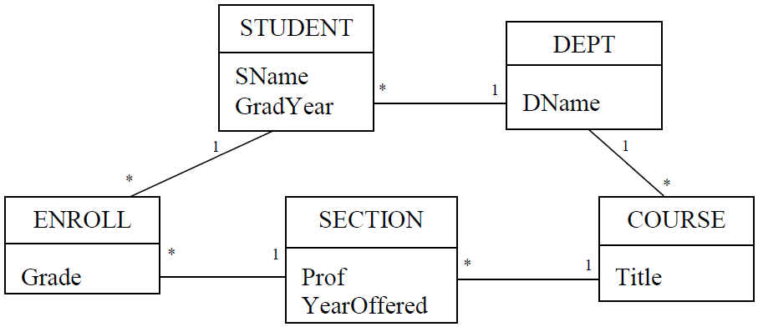
Resulting Class Diagram

Slide 35
Class Diagrams Easier Than Relational
Class diagrams represent schemas visually
Tables represent relationships via foreign keys
A picture is worth 1000 words
It’s easier to work graphically
Easiest way to change a relational schema is to transform it to class diagram, modify it, and then transform it back

Slide 36
Class Diagrams Easier Than Relational
It’s easier to understand what tables are involved and how they are related
Easier to create queries

Slide 37
CLASSES
TO TABLES

Slide 38
Class Diagrams ➔ Relational Schema
Create a table for each class, whose fields are the attributes of that class.
Choose a primary key for each table. If there is no natural key, then add a field to the table to serve as an artificial key.
For each weak-strong relationship, add a foreign key field to its weak-side table to correspond to the primary key of the strong-side table.

Slide 39
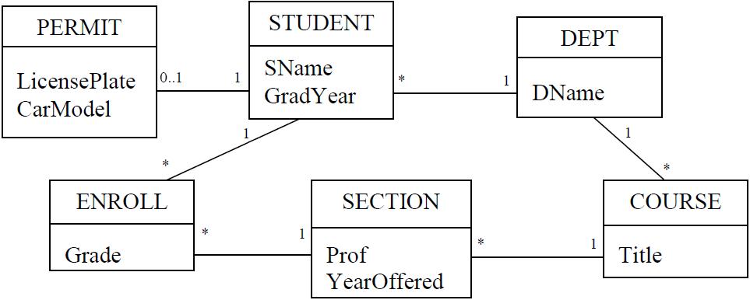
Example Transformation

Slide 40
Resulting Schema
DEPT(DId, DName)
COURSE(Cid, Title, DeptId)
SECTION(SectId, YearOffered, Prof, CourseId)
STUDENT(SId, SName, GradYear, MajorId)
ENROLL(EId, Grade, StudentId, SectionId)
PERMIT(PermitId, LicensePlate, CarModel, StudentId)

Slide 41
Natural Keys and Strong Relations...
Alternatively,
if we consider natural keys, and
One-one relationships
Department name is already unique
DEPT(DId, DName)
DEPT(DName)

Slide 42
Natural Keys and Strong Relations
Therefore foreign key is now the department name
STUDENT(SId, SName, GradYear, MajorId)
STUDENT(SId, SName, GradYear, MajorName)

Slide 43
Using Natural Keys
There’s a 1-1 relationship, we can use the same student ID
PERMIT(PermitId, LicensePlate,
CarModel, StudentId)
PERMIT(StudentId, LicensePlate, CarModel)

Slide 44
Using Natural Keys
Since students can enroll in a section only once, the compound key is already unique
Also, no one refers to ENROLL
ENROLL(EId, StudentId, SectionId, Grade)
ENROLL({StudentId, SectionId}, Grade)

Slide 45
Using Natural Keys
Title is already unique, and foreign key is the department name
COURSE(Cid, Title, DeptId)
COURSE(Title, DeptName)
Foreign key is now the course title
SECTION(SectId,YearOffered,Prof,CourseId)
SECTION(SectId,YearOffered,Prof,Title)

Slide 46
Algorithm Limitations
The algorithm only deals with weak-strong relationships
No strong-strong or weak-weak relationships yet
We’ll work on those later

Slide 47
REQUIREMENTS
ANALYSIS

Slide 48
Design Good Class Diagrams
Create a requirements specification
Create a preliminary class diagram from the nouns and verbs of the specification
Check for inadequate relationships in the diagram
Remove redundant relationships from the diagram
Revise weak-weak and strong-strong relationships
Identify the attributes for each class
Apply 3-6 in any order. Might need revisit other steps

Slide 49
Requirements Analysis
Determine the data to store
Interview users how they’ll use the database
Examine data-entry forms
Determine intended database queries
Examine reports generated from database
Result is a requirements specification

Slide 50
Example Requirements Spec
The university is composed of departments. Academic departments (such as the Mathematics and Drama departments) are responsible for offering courses. Non-academic departments (such as the Admissions and Dining Hall departments) are responsible for the other tasks that keep the university running.

Slide 51
Example Requirements Spec
Each student in the university has a graduation year, and majors in a particular department. Each year, the students who have not yet graduated enroll in zero or more courses. A course may not be offered in a given year; but if it is offered, it can have one or more sections, each of which is taught by a professor. A student enrolls in a particular section of each desired course.

Slide 52
Example Requirements Spec
Each student is allowed to have one car on campus. In order to park on campus, the student must request a parking permit from the Campus Security department. To avoid misuse, a parking permit lists the license plate and model of the car.

Slide 53
Example Requirements Spec
The database should:
allow students to declare and change major department;
keep track of parking permits;
allow departments, at the beginning of each year, to specify how many sections of each course it will offer for that year, and who will teach each section;
allow current students to enroll in sections each year;
allow professors to assign grades to students in their sections.

Slide 54
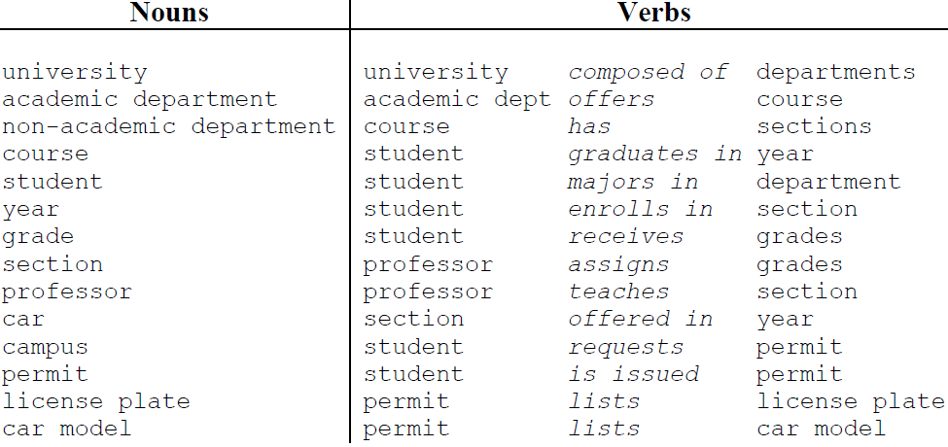
Preliminary Class Diagram
Extract relevant concepts from requirements spec
Nouns describe entities
Verbs describe relationships between entities

Slide 55
Database Scope
Requirements spec defines the scope
Only student enrollment
No employee, financial, or resources issues
Some nouns are irrelevant or redundant
University and campus ‒ Composed of
Car ‒ Requests
Non-academic department
Interview and discuss with stakeholders

Slide 56
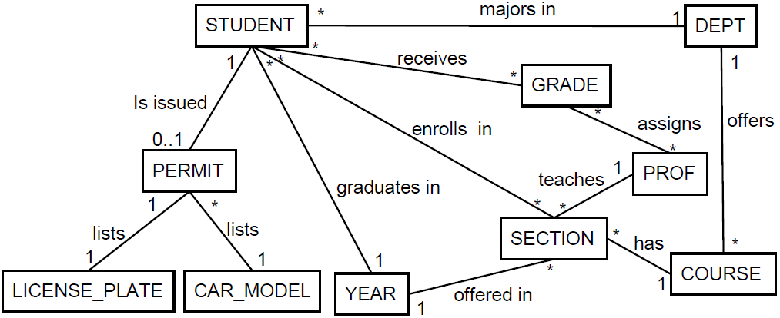
Preliminary Class Diagram
Revised list of nouns and verbs yields initial diagram
Relationships derived from verbs

Slide 57
ANALYZING RELATIONSHIPS

Slide 58
Inadequate Relationships
Relationships describe how entities connect
From STUDENT record we can follow relationships
majors in to get to corresponding DEPT entity
enrolls in to get all SECTION entities
enrolls in and has to get all COURSE entities

Slide 59
Inadequate Relationships
What if we had chosen STUDENT enrolls in COURSE
This relationship is inadequate because we can’t tell which section the student is in
Make sure relationships convey intended meaning

Slide 60
Inadequate Relationships...
Exhaustively consider every path
Make sure diagram captures desired information

Slide 61
Inadequate Relationships...
A couple more inadequate relationships:
receives captures grade for each student but not section
assigns captures grades prof gave but no student or section
receives
assigns

Slide 62
Inadequate Relationships
This happened because we oversimplified requirement spec interpretation
“student receives grades”
“student receives grade for an enrolled section”
“professor assigns grade”
“professors to assign grades to students in their sections”

Slide 63
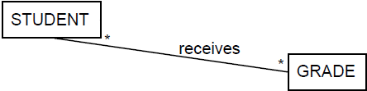
Multi-Way Relationships...
Involve three or more classes, (>2 nouns) e.g.:
“student receives a grade for an enrolled section”
“professor assigns grade to student in section”
Consider

Slide 64
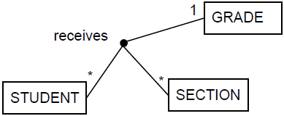
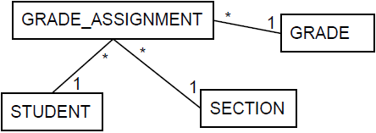
Multi-Way Relationships
Two ways to represent multi-way relationships
Line connects all New class relates all
Conceptual Concrete (Reified)

Slide 65
Lines Connecting Various Classes
“1” next to GRADE → one grade/student/section
“*” next to STUDENT means many students in a section with same grade
“*” next to SECTION means many sections/student with same grade

Slide 66
Use Class as Relationship to Reify
Replace receives with class GRADE_ASSIGNMENT
GRADE_ASSIGNMENT record per grade assigned
This will eventually become the ENROLL table

Slide 67
Reification : To Make Concrete
reification converts relations → classes
Relation → class, similar to verb → noun
“Receives” → “reception” or “receiving”
Reification is easier than 3-way relations
It’s easier to deal with binary relations
It’s more flexible
Each new class can have it’s own attributes
Apply reification to relationship assigns
New class has one record per grade
But we have class already: GRADE_ASSIGNMENT

Slide 68
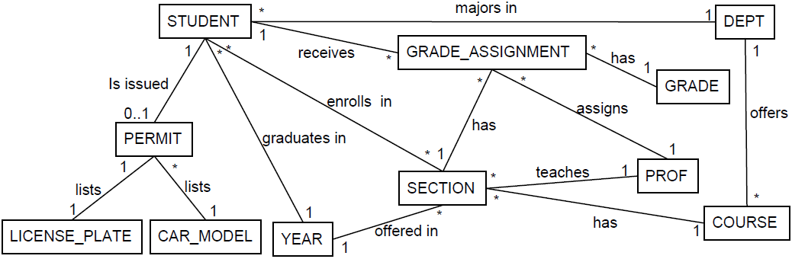
GRADE
After Reifying Inadequate Relations
GRADE_ASSIGNMENT

Slide 69
Redundant Relationships...
Consider the query “all sections a student is enrolled in”
Obvious solution is to use enrolls in relationship
But another solution is path from STUDENT to GRADE_ASSIGNMENT to SECTION
Enrolls in relationship is redundant.
A relationship is redundant if removing it does not change the information content of the class diagram

Slide 70
Redundant Relationships
“all sections a student is enrolled in”
STUDENT -- enrolls in -- SECTION
Redundant with
STUDENT -- GRADE_ASSIGNMENT -- SECTION
STUDENT
SID
1
2
3
...
123
GRADE_ASSIGNMENT
SID | GID | SECID
1 |  | 001
1 |  | 002
1 |  | 003
2 |  | 001
2 |  | 002
2 |  | 003
SECTION
SECID | CID
001 | 111
002 | 222
003 | 333
004 | 111
005 | 222
006 | 333
COURSE
CID
111
222
333
444
555
777

Slide 71
Redundant Relationships
The assigns relationship is also redundant
Describes who assigned each grade
But PROF assigns all the grades of a SECTION
We know PROF of each SECTION
Don’t need each assignment, just PROF of section
GRADE_ASSIGNMENT
* *
has
assigns
1
1
SECTION
*
1
PROF
teaches

Slide 72
Check All Relationships for Redundancy
Consider relationship majors in
STUDENT
*
majors in
1
DEPT
1
receives
1
*
GRADE_ASSIGNMENT
offers
has
*
1
*
SECTION
COURSE
*
has
1

Slide 73
Check All Relationships for Redundancy
Check redundancy with STUDENT, GRADE_ASSIGNMENT, SECTION, COURSE, DEPT
But this path describes the DEPT, offering the COURSE, as opposed to the STUDENT’s major
So, majors in is not redundant

Slide 74
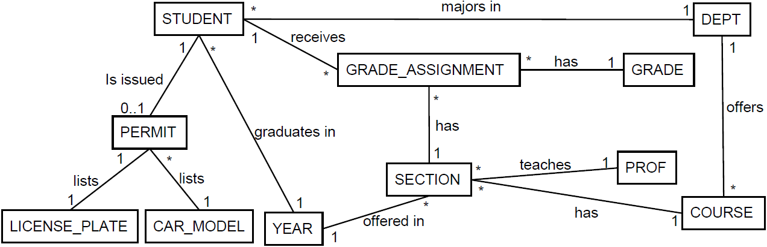
Having Removed all Redundancies
✕
✕

Slide 75
Handling Weak-Weak Relationships
So far algorithm works with weak-strong relations
Convert weak-weak relationships to 2 weak-strong
Consider the many-one relationship majors in between STUDENT and DEPT
STUDENT
*
majors in
1
DEPT

Slide 76
Handling Weak-Weak Relationships
States each student only has one major
What if students could declare various majors?
We would have many-many, weak-weak relationship
STUDENT
*
majors in
*
DEPT

Slide 77
Use Reification To Remove Many-Many
Students can declare several majors
Reifying the many-many relationship we get
STUDENT
*
majors in
*
DEPT
STUDENT
1
*
STUDENT_MAJOR
*
1
DEPT

Slide 78
Use Reification To Remove Many-Many
There’s a STUDENT_MAJOR record for each major a STUDENT declares
Reifying a many-many relationships creates an equivalent diagram without many-many

Slide 79
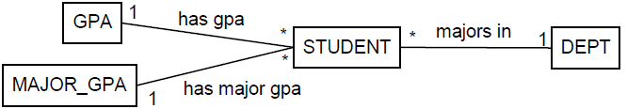
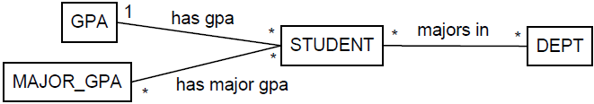
Another Example
Consider storing both GPA and Major GPA
If STUDENT has several majors then has major gpa is many-many
But MAJOR_GPA doesn’t know which DEPT

Slide 80
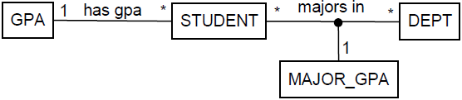
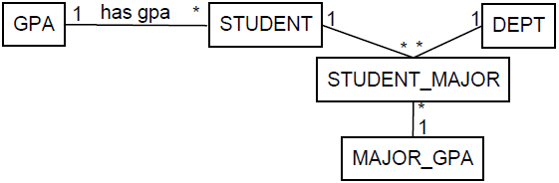
Reify Multi-Way Relationships
We can combine majors in and has major gpa into multi-way relationship
Reifying the multi-way relationship we get

Slide 81
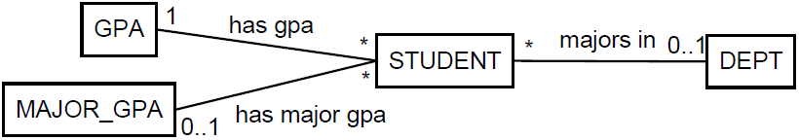
Reifying Weak-Weak Relationships
If students can have at most one major we have
Where we have 0..1 next to MAJOR_GPA & DEPT
The major is now optional
Now we DO know which MAJOR_GPA for DEPT
But there shouldn’t be a MAJOR_GPA with no DEPT
There should be MAJOR_GPA only if there is a DEPT

Slide 82
Reifying Weak-Weak Relationships
Since one should not exist without the other, they really should be part of the same thing
It should be part of a multi-way relationship
Then we can apply reification on the multi-way relationship and end up with

Slide 83
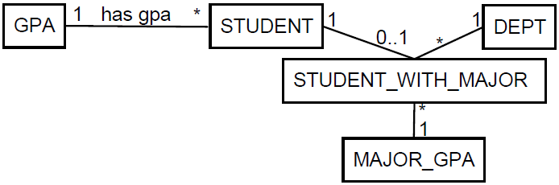
Reifying Weak-Weak Relationships
The 0..1 indicates that the relation is optional, but if there is, then there’s 1 DEPT and one MAJOR_GPA

Slide 84
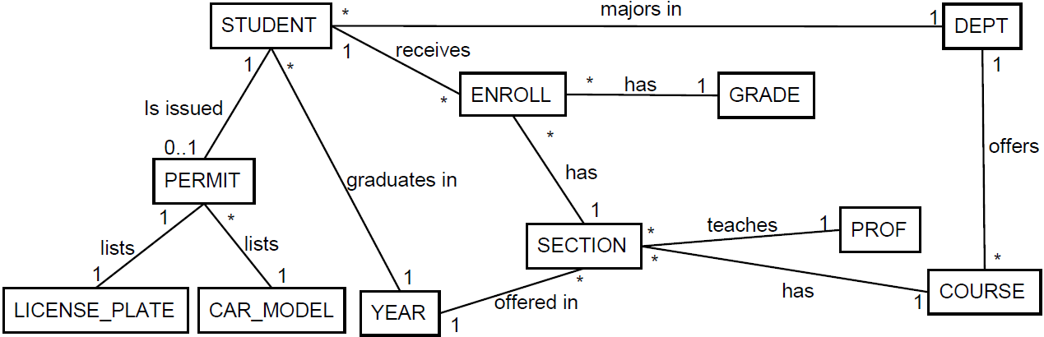
Weak-Weak With 0..1 Annotations
Consider the PERMIT --- STUDENT relationship
Suppose PERMITs are given to STUDENTS and STAFF and student’s can expire

Slide 85
Weak-Weak With 0..1 Annotations
A symmetrical relationship
Students can have at most one permit, but some students will have no permits
Each permit can be issued to at most one student, but only some permits will be issued to students

Slide 86
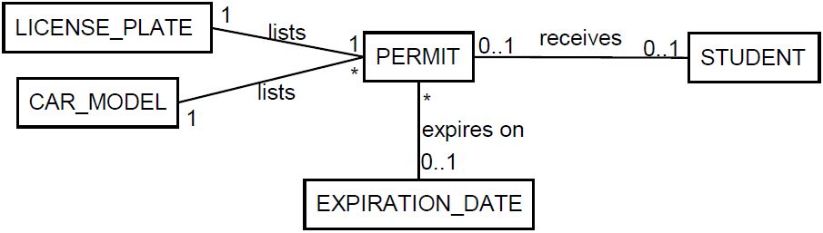
Weak-Weak With 0..1 Annotations
Both sides have 0..1 annotations:

Slide 87
But...
But expires on depends on receives, i.e., only want EXPIRATION_DATE if the student gets a permit
One can't exist without the other. They are part of the same multi-way relationship

Slide 88
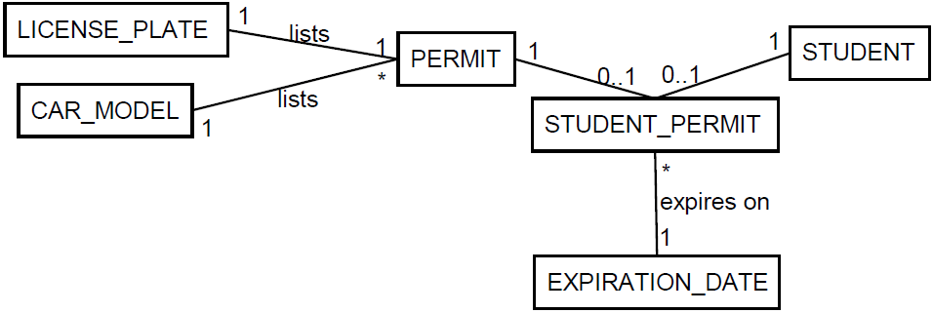
...But
We can combine the relations and then reify:

Slide 89
Reify weak-weak relations to remove them so our algorithm works
Weak-weak relations are often part of a multi-way relationship

Slide 90
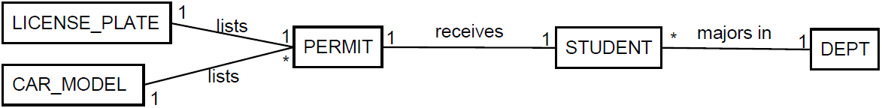
Strong-Strong Relationships
Strong-strong relations have 1 on both sides, that is, entities are in one-to-one correspondence
If University required all students to get a permit, then STUDENT, PERMIT would be in a 1-to-1

Slide 91
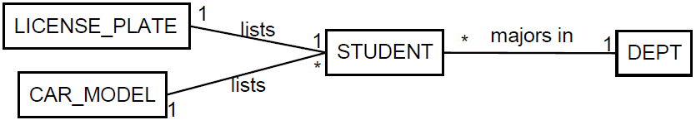
Strong-Strong Relationships
We can either
merge the classes together or
leave the relationship alone and then treat it as weak and maybe treat it as attribute of the other class
Below we merged PERMIT into STUDENT and left LICENSE_PLATE alone

Slide 92
ATTRIBUTES
VS CLASSES

Slide 93
Adding Attributes to Classes...
All nouns can't be classes.
Nouns for real life entities are classes, e.g., student
Nouns for values are attributes, e.g., year
But it really depends on the level of abstraction we choose

Slide 95
Adding Attributes to Classes
Consider a license plate
Do we just care about the value of plate (attribute)
Or do we care about several aspects, i.e., state, design, physical condition (class)
Depends on the requirements and domain to decide whether we care about this minutia

Slide 96
Classes Vs. Attributes
Depending on domain, noun can be class or attribute
Consider a professor
If it’s just the name we care as part of a course, then attribute
If we need to maintain an official list of professors, then it’s a class
Same thing for departments
If we want to keep track of all departments, it’s a class
Represent a noun as a class if we want to keep an explicit list of its entities

Slide 97
Transforming Classes into Attributes
Let C be the class that we want to turn into an attribute
Add an attribute to each class that is directly related to C
Remove C (and its relationships) from the class diagram

Slide 98
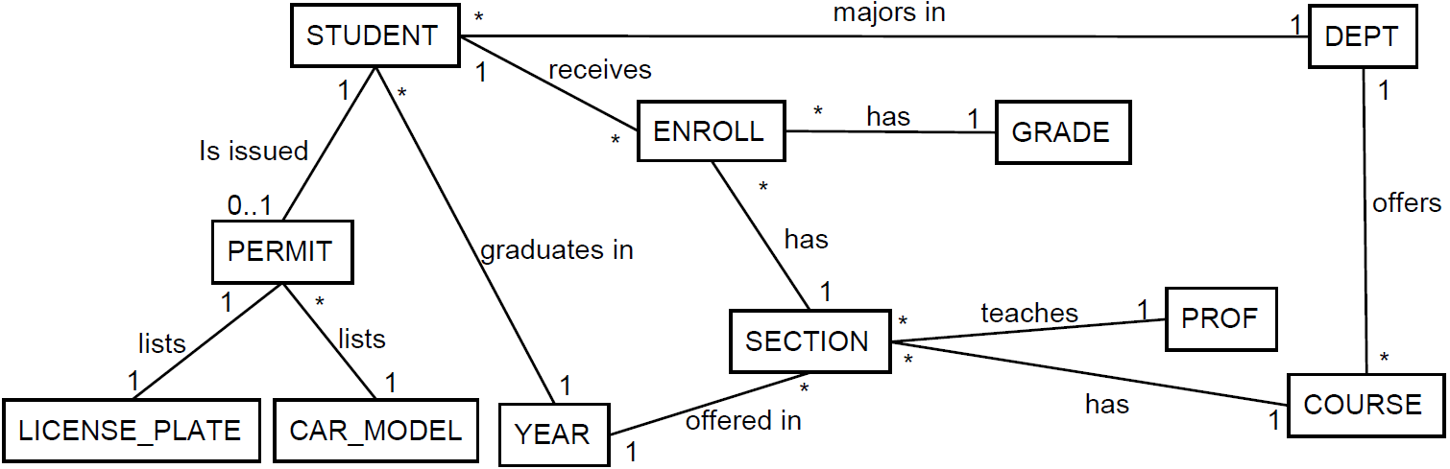
Consider the Following Class Diagram
Let’s convert the following classes to attributes
GRADE PROF
YEAR LICENSE_PLATE
CAR_MODEL

Slide 99
Classes to Attributes...
GRADE is only related to ENROLL
We add grade to ENROLL and remove the GRADE class
PROF is only related to SECTION
We add prof to SECTION and remove the SECTION class

Slide 100
Classes to Attributes
LICENSE_PLATE & CAR_MODEL are only related to PERMIT
We add licensePlate and carModel to PERMIT and remove those classes
YEAR related to both STUDENT and SECTION
We add year to both classes and remove the YEAR class

Slide 101
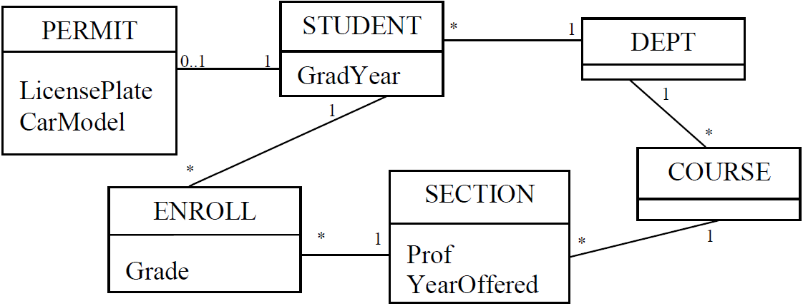
Classes to Attributes
Having converted the following classes to attributes
GRADE PROF
YEAR LICENSE_PLATE
CAR_MODEL

Slide 102
Adding Additional Attributes...
Often requirements are incomplete and do not contain necessary classes or attributes
Obvious attributes
Assumed attributes

Slide 103
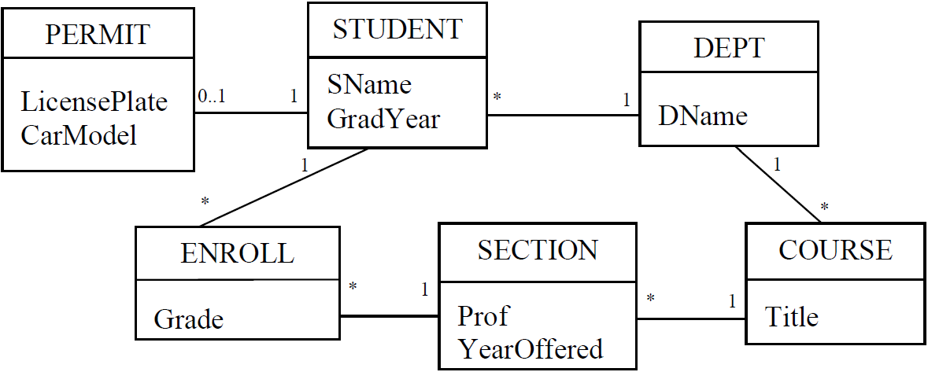
Adding Additional Attributes
E.g., student name, department name, course title

Slide 104

Attribute Cardinality...
Just like classes, attributes have cardinality: single-valued or multi-valued
Consider the many-one relationship teaches between SECTION and PROF

Slide 105

Attribute Cardinality
Each section has a single professor, so the prof attribute in SECTION is single valued
If many-many, then multi-valued

Slide 106
Implementing Single / Multi Valued
Single-valued just correspond to fields in a table
Many relational databases support collection types such as lists and arrays
These can be used to implement multi-valued
Otherwise, use reification to remove the many-many relationships

Slide 107
AGGREGATION, COMPOSITION, & GENERALIZATION

Slide 108

Aggregation
Aggregation describes a part-whole or part-of relationship
No lifecycle dependency, i.e., an engine can exist without the car
Implied 0..1 cardinality on the whole
0..1
0..1
0..1

Slide 109

Composition
Composition describes an owns a relationship
Strong life cycle dependency, i.e., Hand can’t exist without its Person
Implied 1..1 cardinality on the whole
1
1

Slide 110
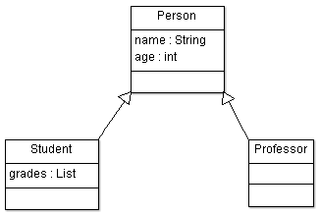
Generalizations / Inheritance
Generalization describes an is a relationship
The can be converted to relational model by creating separate tables for base and subclasses
Subclass entities have a strong 1-1 relation with base
is a
is a

Slide 111

Transforming Generalizations
Consider the following diagram
PERSON(PId, Name, Age)
PROFESSOR(PId, Office)
STUDENT(PId, Grades)
Base has common fields, but 1-1 with derived

Slide 112
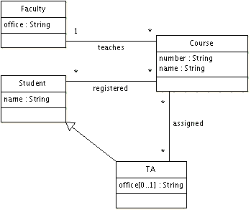
Example

Slide 113
Faculty – Course Strong-Weak Relation
create table Faculty(
id int primary key,
office varchar(255) not null
);
create table Course(
number varchar(255) primary key,
name varchar(255),
taughtBy int not null references Faculty(id)
);

Slide 114
Generalization
create table Student(
id int primary key,
name varchar(255)
);
create table TA(
office varchar(255)
id int primary key references Student(id)
on delete cascade
);

Slide 115
Reify Weak-Weak Relationship
create table assigned(
ta int references TA(id),
course varchar(255) references Course(number),
primary key(ta, course)
);
create table registered(
student int references Student(id),
course varchar(255) references Course(number), primary key(student, course));

Slide 116
Another Example
Requirements:
Vehicles may be parked in a garage. Every garage has an address. Some vehicles are cars, and some are boats. Every vehicle has a unique vin (vehicle identification number) and a power rating (in horsepower). A vehicle has an owner. A car has a number of tires. A boat has a number of propellers and may have a name.

Slide 117
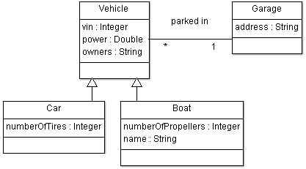
Design

Slide 118
create table Garage(
id int primary key,
address varchar(255) not null
);
create table Vehicle(
vin int primary key,
power double not null,
owner varchar(255),
parkedIn int references Garage(id)
);

Slide 119
create table Car( /* Subclass of Vehicle */
numberOfTires int not null,
vin int primary key references Vehicle(vin)
on delete cascade
);
create table Boat( /* Subclass of Vehicle */
numberOfPropellers int not null,
name varchar(255),
vin int primary key references Vehicle(vin)
on delete cascade);

Slide 120
ASSOCIATION CLASSES

Slide 121
Association Classes
Use an association class (AC) to capture additional attributes about an association
AC's primary key is composition of foreign keys to related classes
FLIGHT
flightNumber
departureTime
flightDuration
FREQUENT_FLYER
firstName
lastName
frequentFlyerNumber
flights
passengers
*
*
MILEAGE_CREDIT
baseMiles
bonusMiles

Slide 122
Employee
e1
e2
Company
c1
c2
Reify
EmploymentHistory
e1 | c1
e1 | c2
e2 | c2
Many to many mapping table

Slide 123
Employee
e1
e2
Company
c1
c2
* *
EmploymentHistory
e1 | c1 | d1 | d2
e1 | c2 | d3 | d4
e2 | c2 | d5 | d6
Association table/class

Slide 124
Associated Classes
create table FLIGHT (
flightNumber int primary key,
departureTime date,
flightDuration time,
);
create table FREQUENT_FLYER (
frequentFlyerNumber int primary key,
firstName varchar(25)
lastName varchar(25));

Slide 125
Association Class Table
create table MILEAGE_CREDIT (
baseMiles int, bonusMiles int,
flightNumber int,
frequentFlyerNumber int,
primary key (flightNumber, frequentFlyerNumber)
foreign key flightNumber references FLIGHT
foreign key frequentFlyerNumber
references FREQUENT_FLYER
on delete cascade);

Slide 126
Another Example
Consider the following class diagram
A person can work at most in one company
A company can have many employees
Employee has a foreign key to company
But what if we want to capture more about that relationship, say the dates of employment
PERSON
* 0..1
COMPANY

Slide 127
History...
We can use association classes to keep a history
Consider a seasonal employee that works at a company at various time intervals over time
they leave
come back
then leaves again
and comes back again

Slide 128
Association Classes
We could capture the extra information in the employee class
But the info is not really about the employee, or the company

Slide 129
History
Capture history with association classes where each entry is different period
It's about the relationship between the two
Use association class EMPLOYMENT
PERSON
*
0..1
COMPANY
EMPLOYMENT
startDate
endDate

Slide 130
Association Classes
create table company (
id int not null,
primary key (id)
);
create table employee (
id int not null,
primary key (id));

Slide 131
Association Classes
create table employment (
companyId int not null,
employeeId int not null,
startDate Date,
endDate Date,
primary key (companyId, employeeId),
foreign key (companyId) references company,
foreign key (employeeId) references employee);

Slide 132
Promoting Association Class
Association Classes can be promoted to full classes
The equivalent UML of the relational model would be
EMPLOYEE
EMPLOYMENT
startDate
endDate
COMPANY
1
0..1
*
1

Slide 133
Student * – * Section * – 1 Course Vs. Student * – * Course 1 – * Section
STUDENT
SId | … | SectId
123 |  | 1
234 |  | 1
345 |  | 2
456 |  | 2
567 |  | 1
678 |  | 1
789 |  | 2
890 |  | 2
SECTION
SectId | … | SId | CId
1 |  | 123 | 111
1 |  | 234 | 111
2 |  | 345 | 111
2 |  | 456 | 111
1 |  | 567 | 222
1 |  | 678 | 222
2 |  | 789 | 222
2 |  | 890 | 222
COURSE
CId | …
111
222
333
444

Slide 134
Student * – * Section * – 1 Course Vs. Student * – * Course 1 – * Section
STUDENT Table
COURSE Table
SECTION Table
SId | … | CId
123 |  | 111
234 |  | 111
345 |  | 111
456 |  | 111
567 |  | 222
678 |  | 222
789 |  | 222
890 |  | 222
CId | … | SId
111 |  | 123
111 |  | 234
111 |  | 345
111 |  | 456
222 |  | 567
222 |  | 678
222 |  | 789
222 |  | 890
SectId | … | CId
1 |  | 111
1 |  | 111
2 |  | 111
2 |  | 111
1 |  | 222
1 |  | 222
2 |  | 222
2 |  | 222

Slide 135
